Slide 1

Assessment

Slide 2
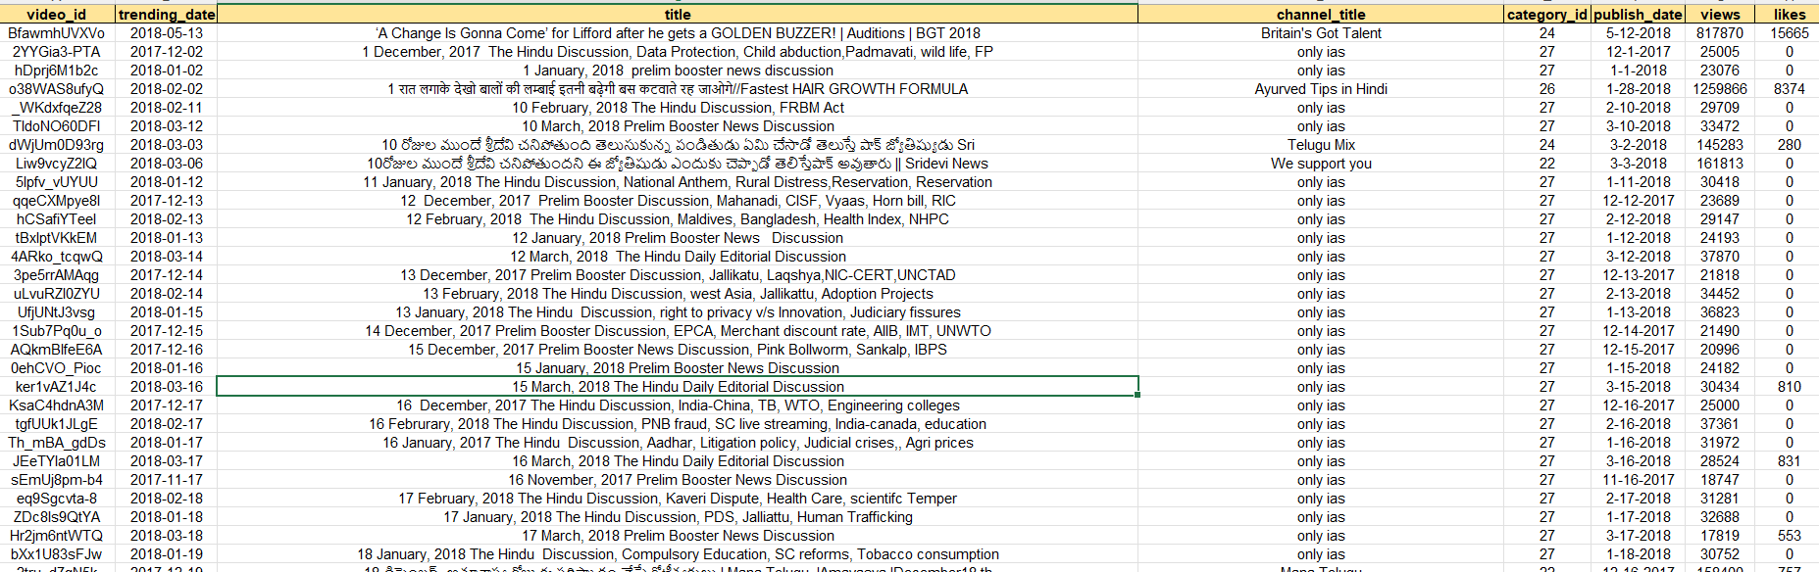
Question 1 I used just button of remove duplicates

Slide 3
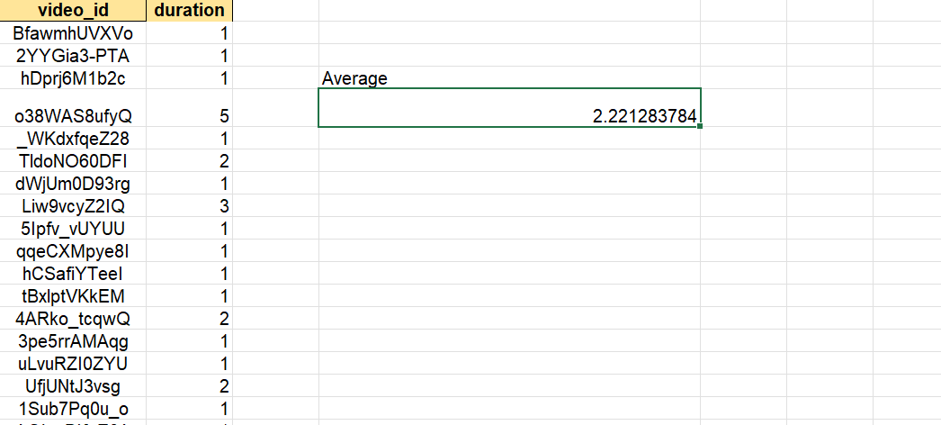
Question 2 Average formula I used

Slide 4
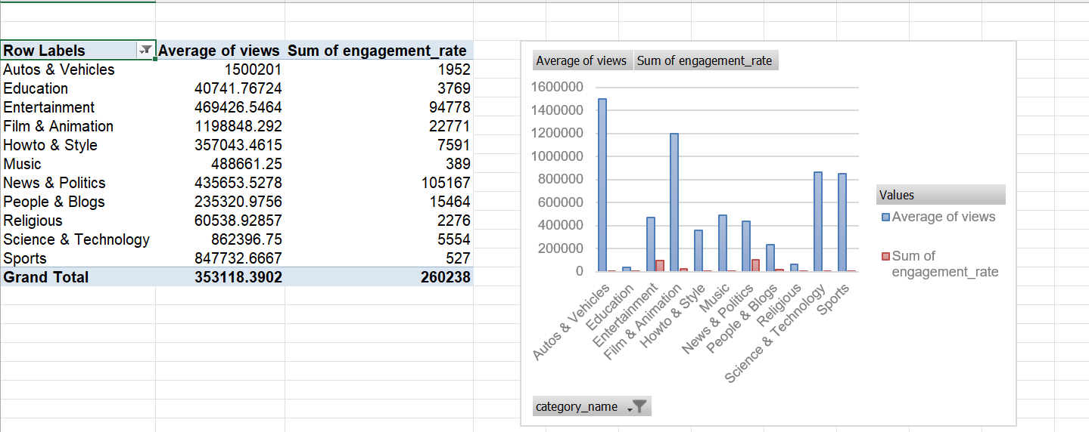
Question 3 insights: the autos and vicheles is having higher views

Slide 5
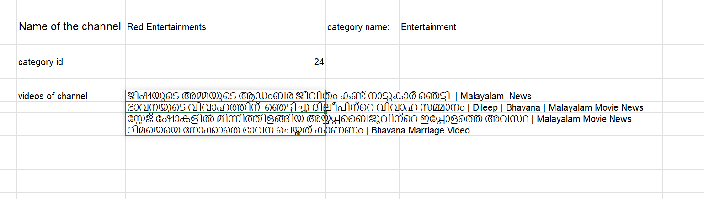
Question 4 =Xlookup(array,include,if empty) =filter formula I used

Slide 6
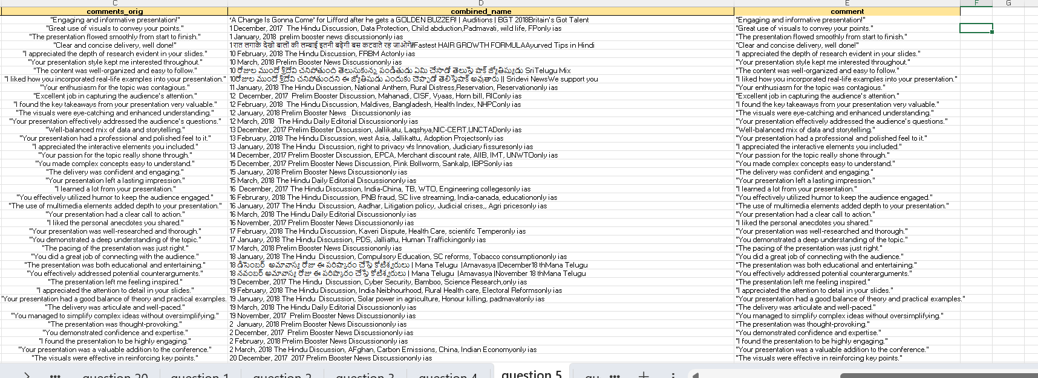
Question 5 I have used textjoin formula

Slide 7
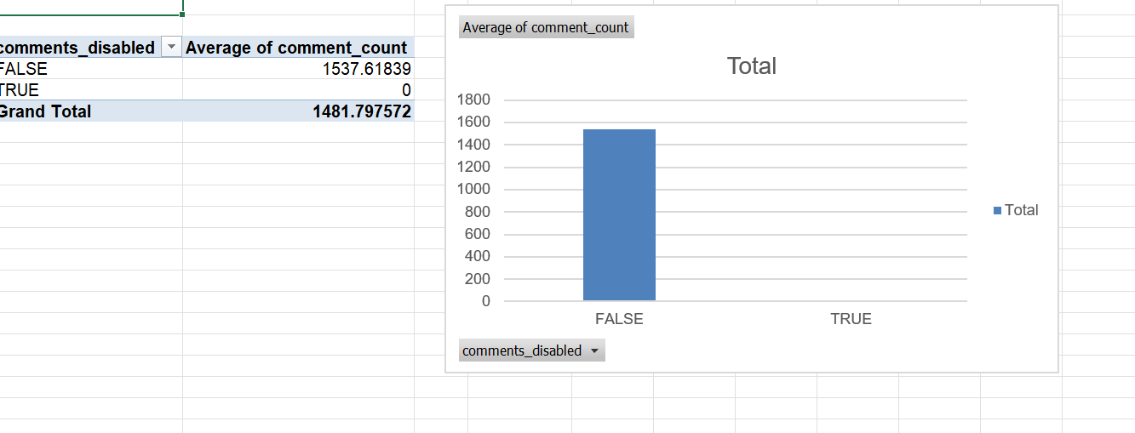
Question 6

Slide 8
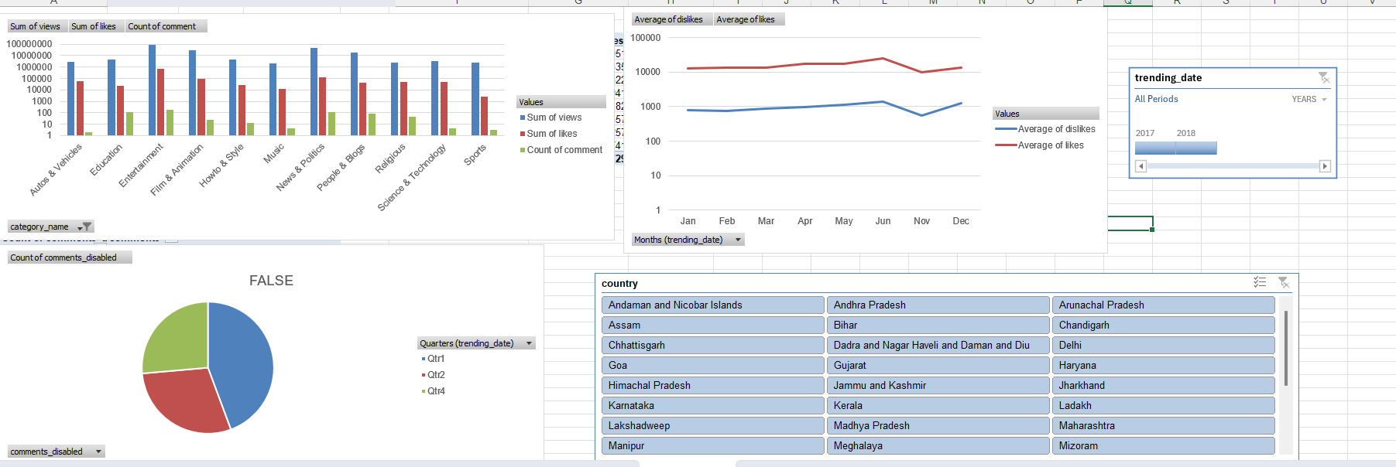
Question 7

Slide 9
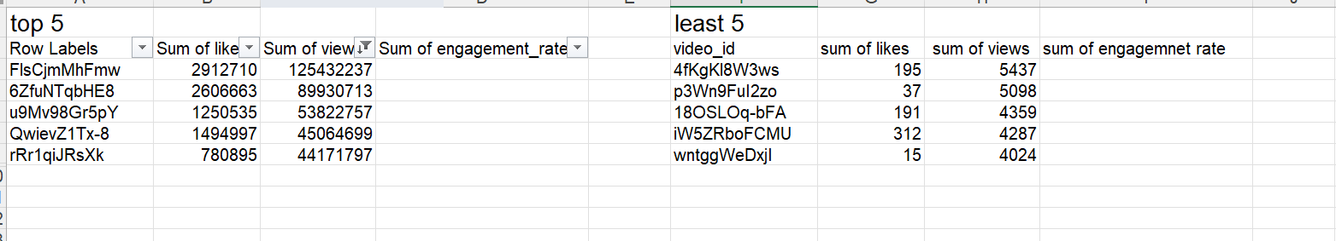
Question 8

Slide 10
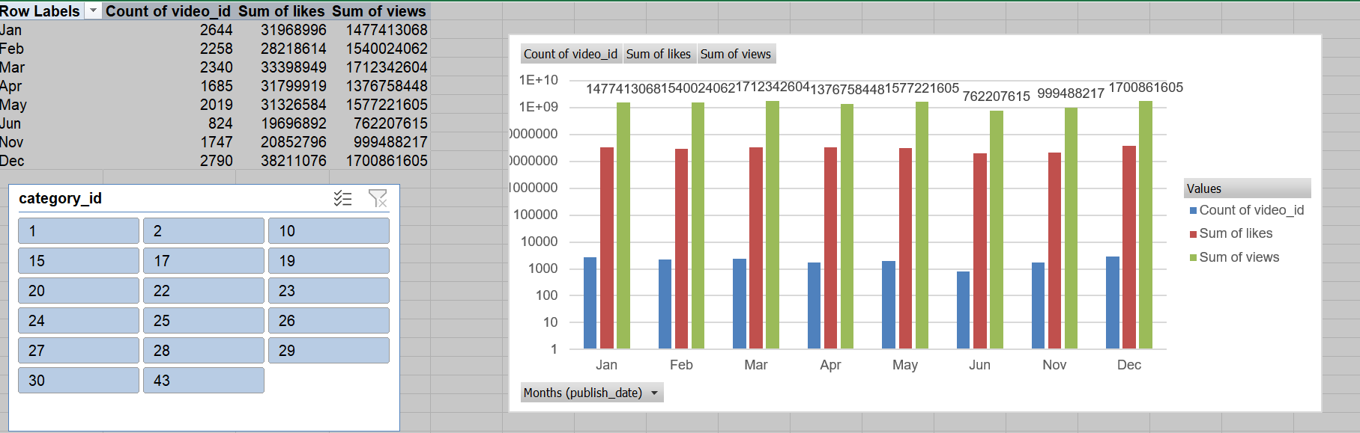
Question 9

Slide 11
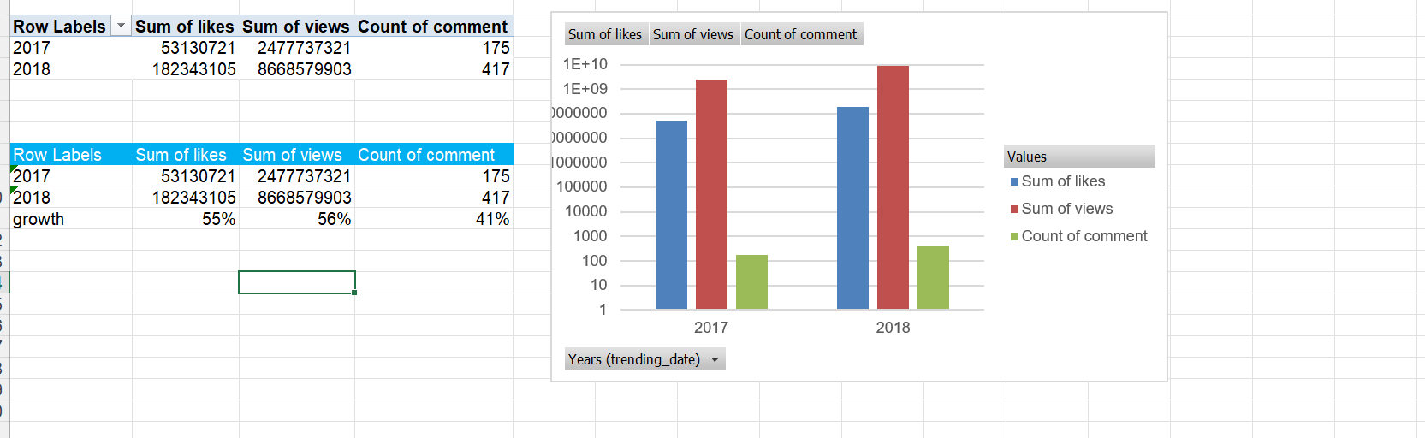
Question 10

Slide 12
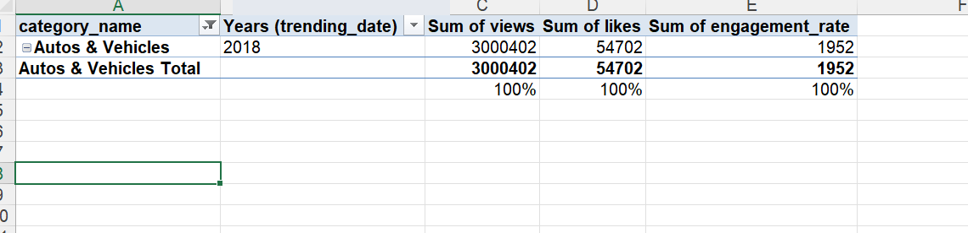
Question 11

Slide 13
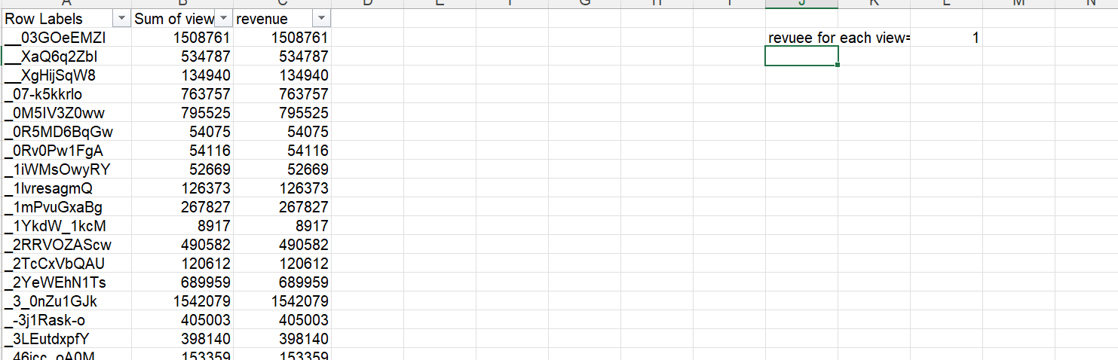
Question 12

Slide 14
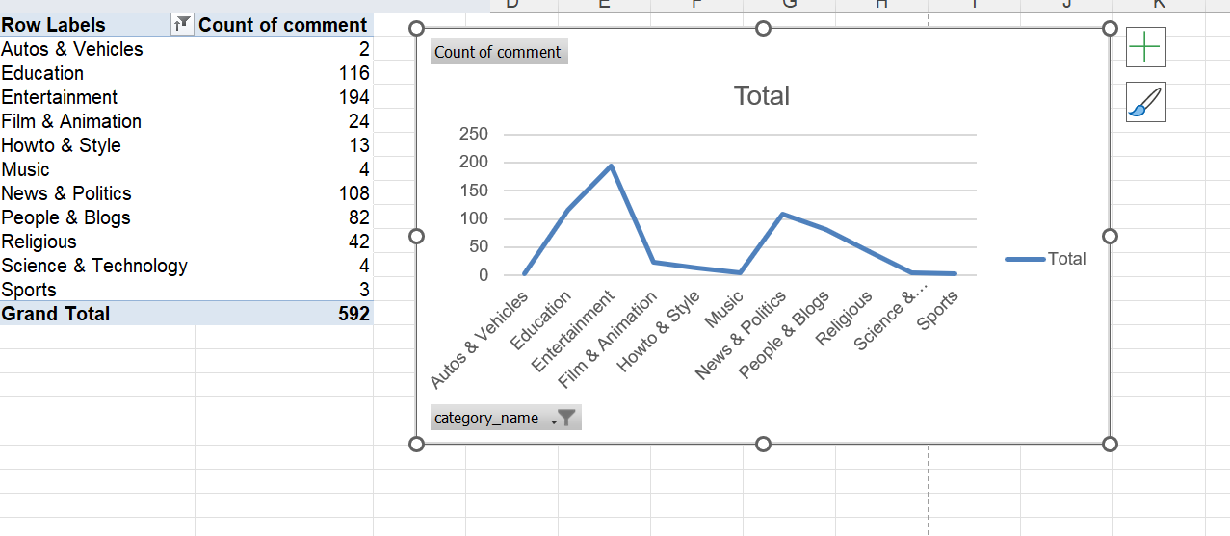
Question 13

Slide 15
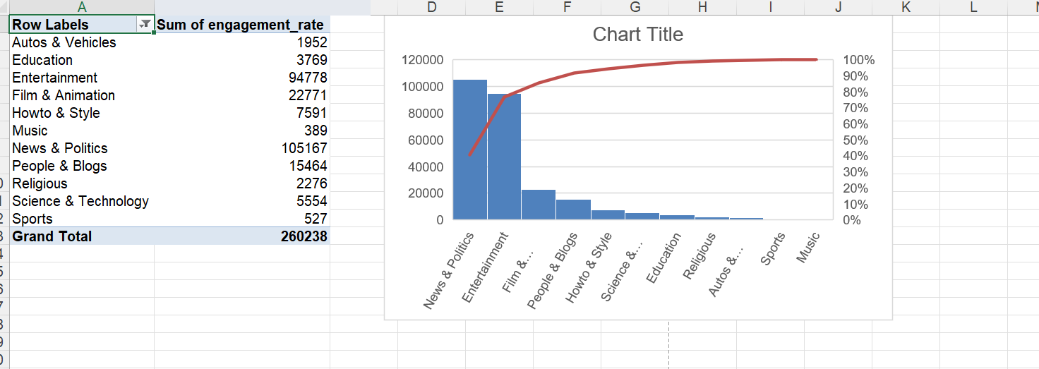
Question 14

Slide 16
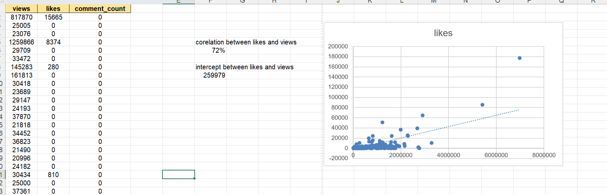
Question 15

Slide 17
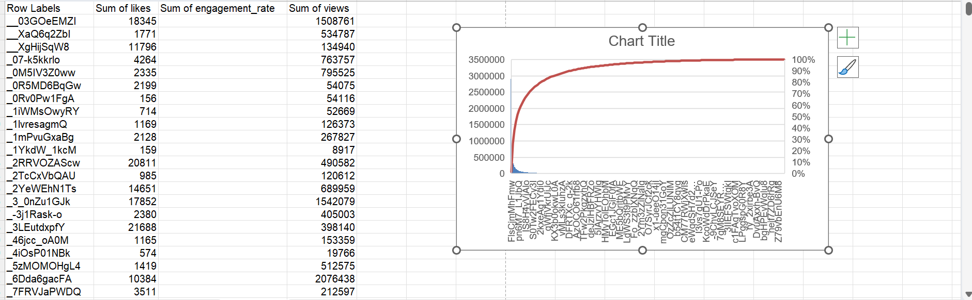
Question 17

Slide 18
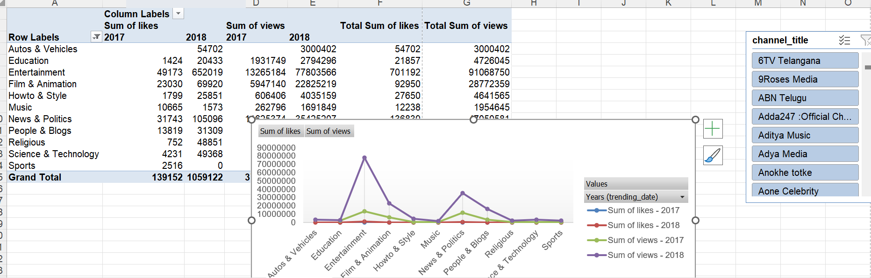
Question 18

Slide 19
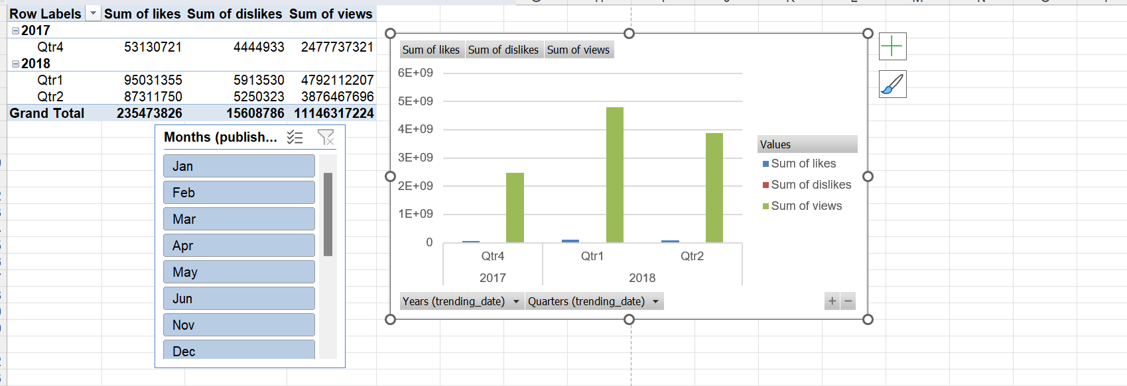
Question 19

Slide 20
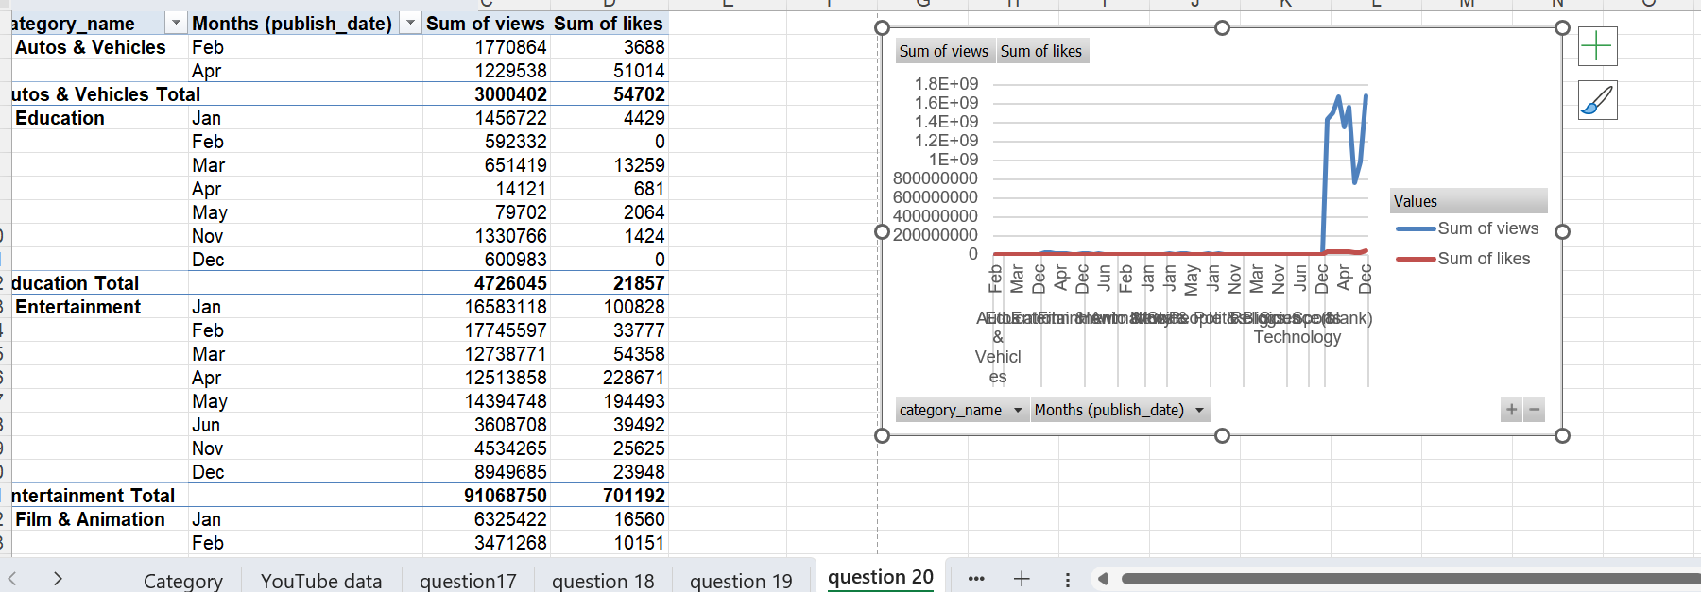
Question 20

